Slide 1
The Cross Product
Dr. Jacob Moore
Associate Professor of Mechanical Engineering
Penn State Mont Alto

Slide 2
The Cross Product
The cross product is a vector operation that can be performed on any two three dimensional vectors.
For 2D problems we need to include zeros for the Z components.
The result of the cross product operation is a vector quantity.
The cross product is particularly useful for moment calculations in 3D, as well as angular velocity and acceleration calculations.

Slide 3
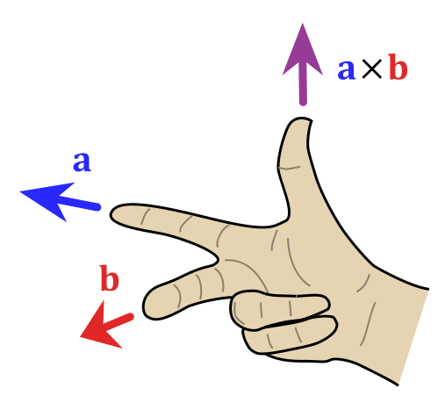



The Cross Product
The cross product of two vectors will be a vector perpendicular to the original vectors, with a magnitude equal to the magnitude of vector one times the magnitude of vector two, times the sine of the angle between them.
C
A
$$\vec{C}=\vec{A} x \vec{B}$$
$$θ$$
$$\left|C\right|=\left|A\right|\left|B\right|sin⁡(θ)$$
B

Slide 4
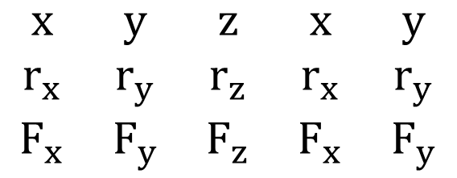
Cross Products
To calculate the cross product by hand, first write out x, y and z in a row, then write the x, y, and z components of the r vector below that, and then the x, y, and z components of the F vector below that.
Next repeat the first two columns after the 3rd column. (repeating the x and y components)
$$\begin{matrix}x & y & z & x & y \\ r_{x} & r_{y} & r_{z} & r_{x} & r_{y} \\ F_{x} & F_{y} & F_{z} & F_{x} & F_{y}\end{matrix}$$

Slide 5



Cross Products
$$\begin{matrix}x & y & z & x & y \\ r_{x} & r_{y} & r_{z} & r_{x} & r_{y} \\ F_{x} & F_{y} & F_{z} & F_{x} & F_{y}\end{matrix}$$
The cross product of the two vectors will give us a third vector (The moment vector in our case).
Each component of the moment vector is as follows.
$$M_{x}=\left(r_{y}∗F_{z}\right)−\left(r_{z}∗F_{y}\right)$$
$$M_{y}=\left(r_{z}∗F_{x}\right)−\left(r_{x}∗F_{z}\right)$$
$$M_{z}=\left(r_{x}∗F_{y}\right)−\left(r_{y}∗F_{x}\right)$$

Slide 6
Cross Products
The advantage of using the cross product for moment calculations really comes out when we use computer tools.
We can calculate the cross product in Matlab
We can calculate the cross product with online tools.

Slide 7
Thanks for Watching
See other engineering mechanics videos and access the full tool at…

Slide 8
Cross Product Worked Example
Calculate the cross product of force vectors A and B in the diagram below by hand.
y
x
F_{A}= 5 kN
30º
F_{B} = 3 kN

Slide 9



Cross Product Worked Example
Calculate the cross product of vectors A and B shown below by hand.
$$A= \left[1, 3, 5\right]$$
$$B= \left[6, 4, 2\right]$$
$$A x B= ?$$

Slide 10
Cross Product Worked Example
Calculate the cross product of vectors A and B shown below using MATLAB.
$$A= \left[1, 3, 5\right]$$
$$B= \left[6, 4, 2\right]$$
$$A x B= ?$$

Slide 11
Cross Product Worked Example
Calculate the cross product of vectors A and B shown below using Wolfram Alpha.
$$A= \left[1, 3, 5\right]$$
$$B= \left[6, 4, 2\right]$$
$$A x B= ?$$

